Slide 1
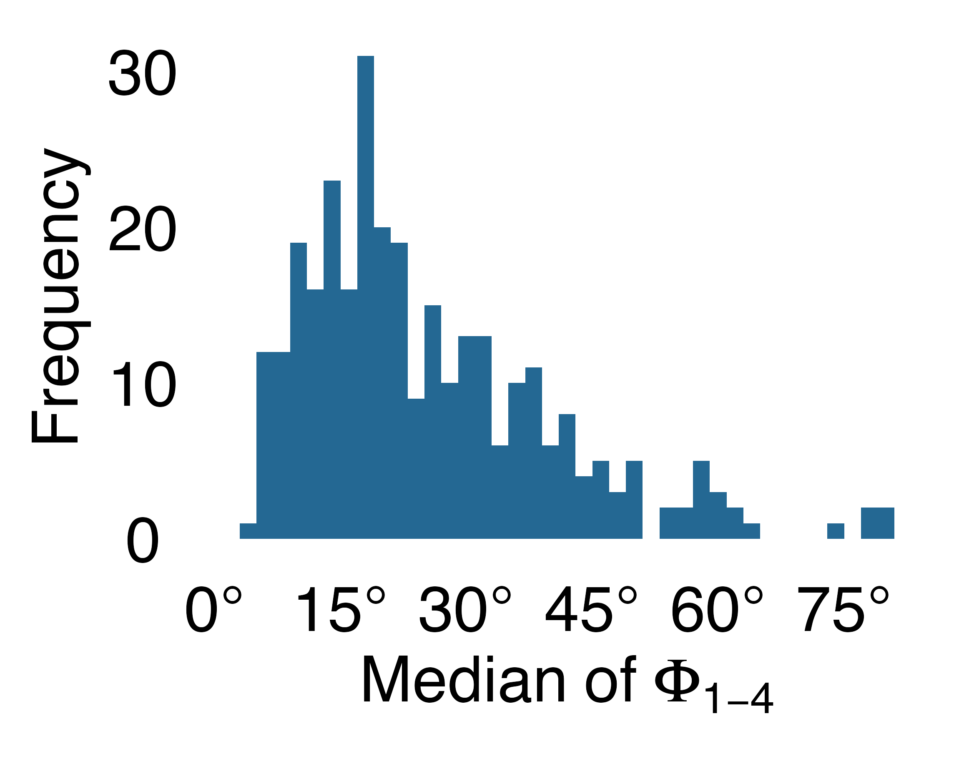
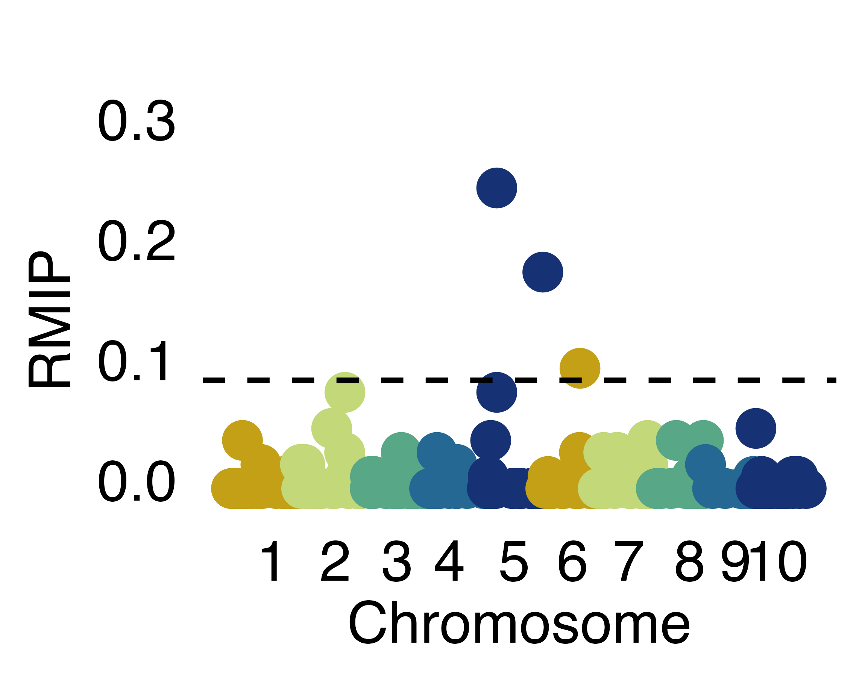
2D RGB Imaging
5 side views + 1 top view
366 plants
3D Reconstruction
Image segmentation
Voxel carving
Skeletonization
Thin voxels classified as leaves or stem
Extract leaf position
236 genotypes from SAP
3 timepoints
Data Processing
Calculate difference of the angle between leaves from 180°
Remove extreme values
Summarize across timepoints
Quantitative Genetic Analysis
Estimate heritability
Resampling FarmCPU GWAS

